Slide 1
What is 3D? Why 3D?
DAY 01 OF 16 · 3D & 6DOF STREAMING
From flat pictures to worlds you can walk into: the motivation for the whole course, and the 6 numbers that describe where you are.
Dimensions
2D vs 2.5D vs 3D
Geometry · topology · semantics
3DoF vs 6DoF
Lab: see it yourself
Book: Ch. 1 · Code: day01_why_3d/
Notes:
Welcome everyone and set the frame for 16 sessions. Say: by the end of this course you will stream a 3D world over a network and walk through it with six degrees of freedom, using code you ran yourself. Today has no heavy maths. The goal is intuition: what a dimension is, why 3D data matters, and why moving your head changes everything. Point to the book on the slide: Chapter 1 of 3D Data Science with Python by Florent Poux is the reading for today. Timing guide for a 90-minute class: 40 minutes of concepts, 35 minutes of lab, 15 minutes of wrap-up and questions.

Slide 2
A photo tells you what something looks like. 3D tells you where everything is.
THE BIG IDEA
Every session in this course builds on that difference, all the way to streaming worlds people can walk through.
Day 01 · What is 3D? Why 3D?
2
Notes:
Read the statement slowly and pause. Then ask the room: name one thing you can do with the 3D model of a room that you cannot do with a photo of it. Collect 3 or 4 answers. Typical answers: measure a distance, check if a sofa fits, walk around an object, let a robot plan a path, see behind something. Each answer is a use of position, not appearance. Bridge: so what exactly is a dimension? Next slide.

Slide 3
A dimension is one number you need to describe something
BOOK CH. 1 · DIMENSIONS
1D
2D
2.5D
3D
One number per item: the temperature of water, the height along one line.
Two numbers: x and y. A photo is a grid of pixels addressed by (x, y).
A depth map: one distance per pixel, from ONE viewpoint. It cannot see behind things.
Three numbers per point: x, y, z. Any point, from any side, as a free set.
01
02
03
04
Day 01 · What is 3D? Why 3D?
3
Notes:
Follow the book’s definition: a dimension is a measurable aspect, the number of variables needed to describe something. Walk through the four cards left to right and give a physical example for each. The important new idea for most students is 2.5D. A depth sensor or a depth map gives exactly one value per pixel, so for one line of sight you can only store the FIRST surface you hit. The book says: you are not working with complete 3D data but rather 2.5D, as you cannot represent two different values for one line of sight. Ask: is a Kinect frame 3D? Answer: it is 2.5D; it becomes a real 3D model only after combining several views (we do that on Day 6).

Slide 4
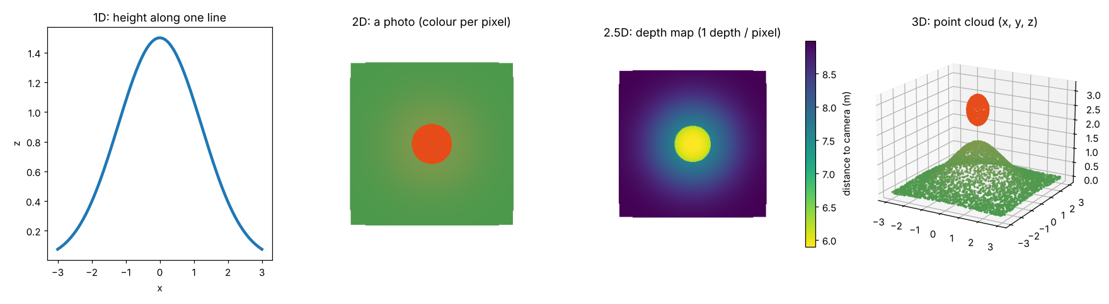
The same object, four ways
LAB PREVIEW
Produced by 01_dimensions.py. In the depth map the hill under the ball is simply gone: one depth per pixel.
Day 01 · What is 3D? Why 3D?
4
Notes:
This figure is generated by the first lab script, so students will reproduce it in 20 minutes. Point at each panel. Left: a single profile line, 1D. Second: the top-down photo has colour but no distance. Third: the depth map; colour now encodes distance to the camera; notice the ball is the closest thing, and the part of the hill underneath the ball does not exist in this data at all. Right: the point cloud, a free set of (x, y, z) points; you can rotate it and see the hill under the ball. Ask: what would you need to recover the hidden part from depth maps? Answer: another viewpoint.

Slide 5
Three layers turn points into understanding
BOOK CH. 1 · BUILDING BLOCKS
Geometry
Topology
Semantics
Size, position, orientation, shape. Where is the wall and how tall is it?
How parts connect: the column supports the floor, doors connect rooms.
What things ARE: this is a kitchen, that is a chair leg.
01
02
03
Day 01 · What is 3D? Why 3D?
5
Notes:
This is the book’s central model: a low-level digital model is geometry only; a high-level model adds topology and semantics so a machine can reason about it. Use the book’s chair example: backrest, seat and four legs (semantics), the legs touch the seat (topology), each part has a shape and position (geometry). Why do we care in a streaming course? Because a smart streaming system can use semantics to send the important objects first, for example a person in high quality and the ground in low quality. We do exactly that idea on Day 9 and Day 14. Keep this slide short: about 4 minutes.

Slide 6
The point cloud: the closest link to reality
BOOK CH. 1 · POINT CLOUDS
What it is
Where it comes from
Why it is hard
A set of {X, Y, Z} points plus attributes such as colour, intensity or class.
LiDAR, photogrammetry, depth cameras, and now generative AI.
Volume, velocity, variety, veracity, value: the five Vs of big data.
01
02
03
Day 01 · What is 3D? Why 3D?
6
Notes:
Introduce the main data type of the first half of the course. The book defines a point cloud as a spatial ensemble of X, Y, Z coordinates with attributes representing the recorded environment. Mention scale: the same idea works from a small object to a whole country. Then the five Vs (book Figure 1-11): volume (billions of points), velocity (new scans every day, or 30 frames per second for volumetric video), variety (many sensors and formats), veracity (noise and errors), value (getting useful information out). Tell students: the five Vs are exactly why streaming 3D is a research problem. Volume and velocity will be our enemies from Day 12 on.

Slide 7
Degrees of freedom: how many ways can the viewer move?
THE STREAMING SIDE
3DoF
3DoF+
6DoF
Rotation only: yaw (turn), pitch (nod), roll (tilt). 360° video. You can look around, but not move.
Rotation plus small head movement while seated. Some parallax, limited range.
Rotation AND translation: x, y, z. Walk, crouch, look behind objects. Needs real 3D content.
01
02
03
Day 01 · What is 3D? Why 3D?
7
Notes:
This is the slide that links 3D data to streaming, the second half of the course. Demonstrate with your own head: turn left and right (yaw), nod (pitch), tilt your ear to your shoulder (roll). Those are the 3 rotational degrees of freedom. Then step left, step forward, crouch: those are the 3 translational ones. 360-degree video only supports the first three: if you lean while watching a 360 video in a headset, the world moves with you, which feels wrong. 6DoF content needs actual 3D geometry because the system must draw the scene from positions nobody filmed. 3DoF+ is the MPEG term for limited head motion around a seated position.

Slide 8
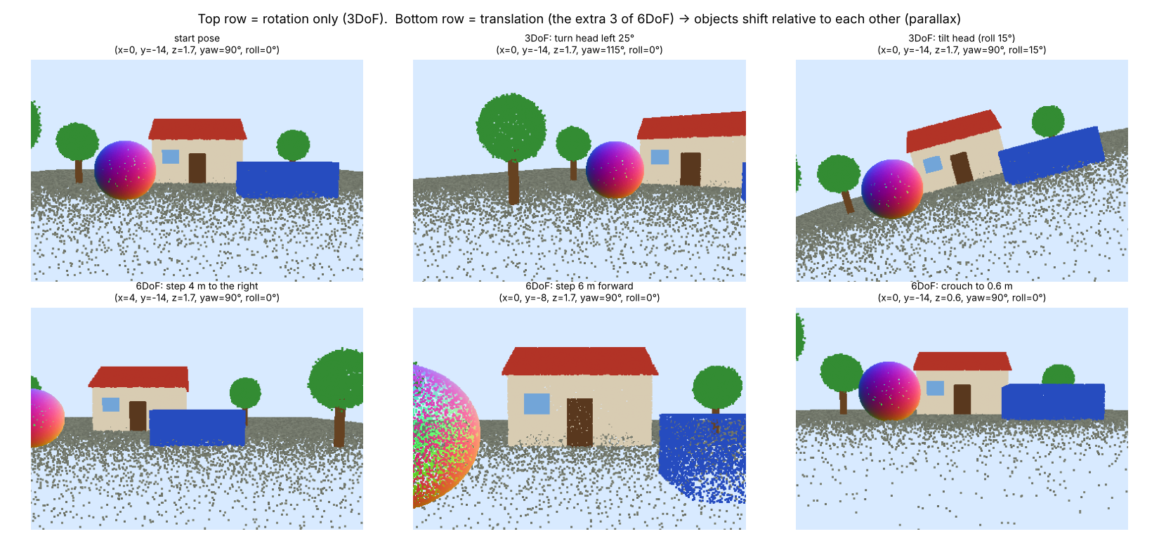
Only translation creates parallax
LAB PREVIEW
Top row: rotation only, objects keep their arrangement. Bottom row: moving changes which object is in front of which.
Day 01 · What is 3D? Why 3D?
8
Notes:
Generated by 02_parallax_3dof_vs_6dof.py. In the top row, turning or tilting the head just shifts or rotates the whole picture: the sphere, house and car keep the same arrangement. In the bottom row, stepping right or forward changes the arrangement: the car hides part of the house, the sphere moves in front. That relative motion is parallax, and it is the main depth cue our brain uses when we move. Key message: a 2D or 360 picture cannot produce parallax for a new position, so 6DoF needs 3D content. Ask: why do VR users get motion sick with 3DoF content? Because their body moved but the image did not respond with parallax.

Slide 9
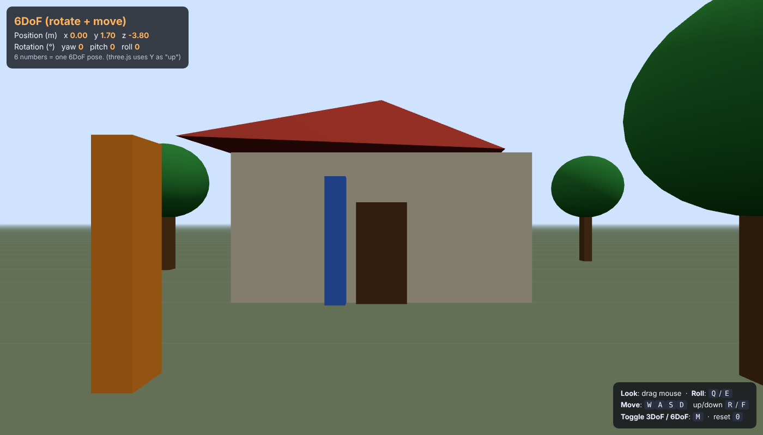
A pose = where you are + where you look
6 NUMBERS
■ x, y, z: position in metres
■ yaw, pitch, roll: orientation in degrees
■ 6DoF client = sends this pose every frame
■ Mind the axes: three.js is Y-up, our Python is Z-up
dof_playground.html. Press M to lock translation (3DoF) and try to look behind the orange pillars.
Day 01 · What is 3D? Why 3D?
9
Notes:
Open the playground live in class if you can: serve the folder with python -m http.server and open dof_playground.html. The panel shows exactly 6 numbers: x, y, z (position) and yaw, pitch, roll (orientation). Tell students: this tuple is called a POSE, and a 6DoF streaming client sends or uses a pose every frame. Ask a volunteer to stand behind the orange pillars in 3DoF mode and try to see the ball; then switch to 6DoF with M and step sideways. Note the small print: three.js uses Y as up, while our Python code and LiDAR data use Z as up. Coordinate conventions are a constant source of bugs; Day 2 is about them.

Slide 10
Run your first two scripts and the playground
HANDS-ON LAB · COPY, RUN, LOOK
RUN IT
cd day01_why_3d
python 01_dimensions.py
python 02_parallax_3dof_vs_6dof.py
python -m http.server 8000
# open localhost:8000/dof_playground.html
→ Rotate the 3D window with the mouse; close it to continue.
→ Open outputs/dimensions.png and outputs/parallax.png.
→ In the playground press M and compare 3DoF and 6DoF.
Day 01 · What is 3D? Why 3D?
10
Notes:
Give 30 to 35 minutes. Before class make sure everyone ran pip install -r requirements.txt and python check_setup.py (see the README); setup problems eat the first lab otherwise. Walk around and check that the Open3D window opens; on servers or some laptops it will not, which is fine because the PNG is saved in outputs. Try-this tasks are in the README of the folder: moving the ball to the side of the hill, adding a combined yaw and translation view. Fast students can do those. Collect one screenshot per student of the playground as attendance.

Slide 11
Three things to remember
1
A dimension is a number you need; 2.5D depth keeps one value per line of sight, 3D keeps them all.
2
Useful 3D = geometry + topology + semantics. Point clouds are the raw geometry.
3
A 6DoF pose is 6 numbers. Only translation creates parallax, so 6DoF needs real 3D content.
BEFORE NEXT SESSION
Read the Ch. 2 maths section of the book. Lab L1 (with Day 2) is in the assignments document.
Day 01 · What is 3D? Why 3D?
11
Notes:
Recap the three points out loud and ask one student to explain 2.5D in their own words. Announce Lab L1, which covers Day 1 and Day 2 and is due before Day 3. Next session: coordinates and transformations, the mathematics of moving 3D data and of describing a pose. Ask students to bring the playground open next time; we will connect the 6 numbers to a 4 by 4 matrix.

